Slide 1
Climate Change and Biodiversity
Nepean Conservation Group AGM, 20 Feb 2021
John Baker

Slide 2
Climate Change & the Emergency
Changes already occurring:
Increasing temperatures
Decreased rainfall
Coastal inundation
Extreme weather events and
Biodiversity loss
One peak goal:
By 2040 we want net
zero-emissions right
across the Peninsula
Notes:
Council declared a Climate Emergency in Aug 2019
Plan was developed and adopted in Aug 2020
10 yr plan, 20 year goal
The plan effects everyone – this is about driving community emissions to zero by 2040
How was it developed?
Consultation with community and lots of people across our organisation – links/integrates and brings together existing and draft strategies and plans, including the 2019 Biodiversity Conservation Plan
Why two documents?
- Detailed plan is 100 pages! Most detailed CE plan to date (internationally) >160 tasks, snapshot 20 pages
Responsibility for climate emergency action will be shared across the entire organisation and our community, led by a Climate Oversight Group composed of shire executive and key staff.

Slide 3
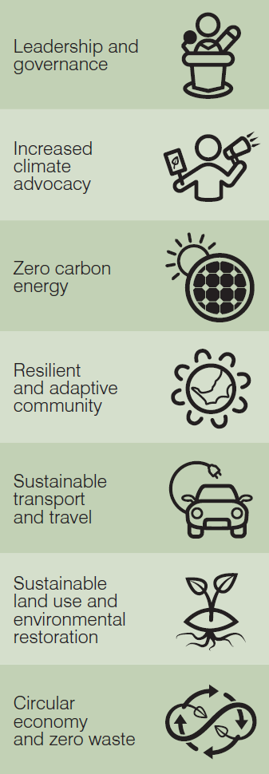
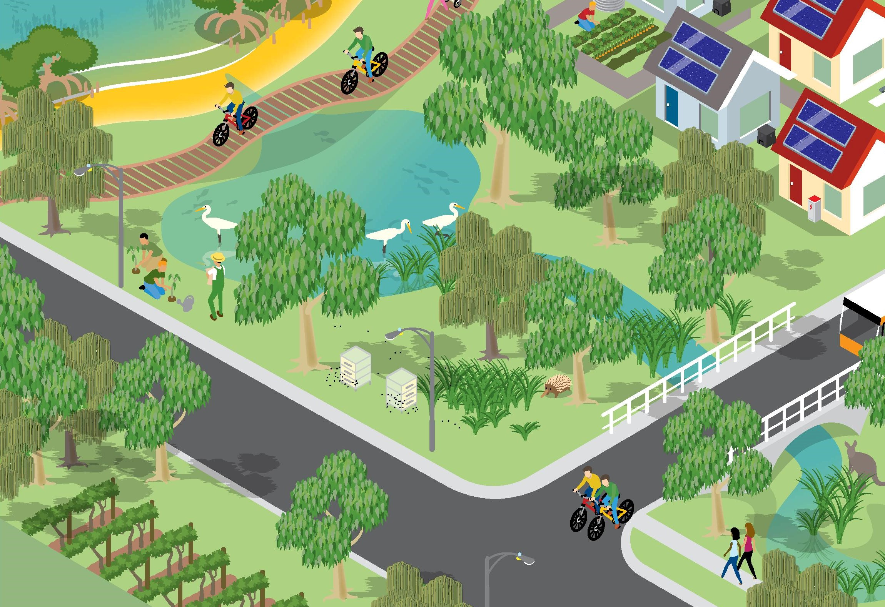
Sustainable Land Use and Environmental Restoration
Notes:
The Plan has ‘Seven Summits’
An important part of this and the 6th Summit is ‘Sustainable Land Use and Environmental Restoration’
Increased heat, decreased rainfall, intense downpours, changing seasonal patterns and increased fire danger are all likely to lead to a loss of habitat, increased salinity of waterways, decreased stream flows, new pest species, and disturbances to lifecycles.
‘View From the Top’ of this Summit
“We will protect and improve our natural landscape, waterways and bays, support and create biodiverse habitats, improve ecosystem resilience, practise regenerative farming and sequester carbon in the landscape; balanced with housing and urban needs.”
Climate change impacts will significantly affect biodiversity in numerous ways.
Climate change alone poses a major threat to biodiversity, but in the context of so many compounding threats, our local ecosystems are especially vulnerable.
If we are to secure the region’s biodiversity and unique ecology, we must amplify our current work and integrate ecological outcomes into all our decision making in order to restore and protect ecosystem resilience. addition to the climate change impacts, biodiversity on the Peninsula faces additional threats stemming from land use change, development, invasive species, population overabundance, pathogens, transport systems and infrastructure, pollution, plus direct human disturbance.
Biodiversity Conservation Plan
The Shire’s 2019 Biodiversity Conservation Plan (BCP) addresses many threats and impacts arising from the Climate Emergency. Accelerating and building on this plan will benefit the local ecology and aid community resilience, economic stability, regional partnerships, sequestration and urban resilience.
The biodiversity crisis is at the core of the Climate Emergency. We are in the middle of a planet-wide mass extinction.19 Business as usual will hasten this trend.
Biodiversity and healthy ecosystems underpin our economy, food system and climate. Without a healthy, sustainable and diverse ecology, these all collapse.
Less than one third of native vegetation remains on the Peninsula, and less than 3% of our ecosystems are in high quality health.
The natural systems on the Mornington Peninsula are at risk of collapse, rapidly approaching the emergency tipping point.

Slide 4
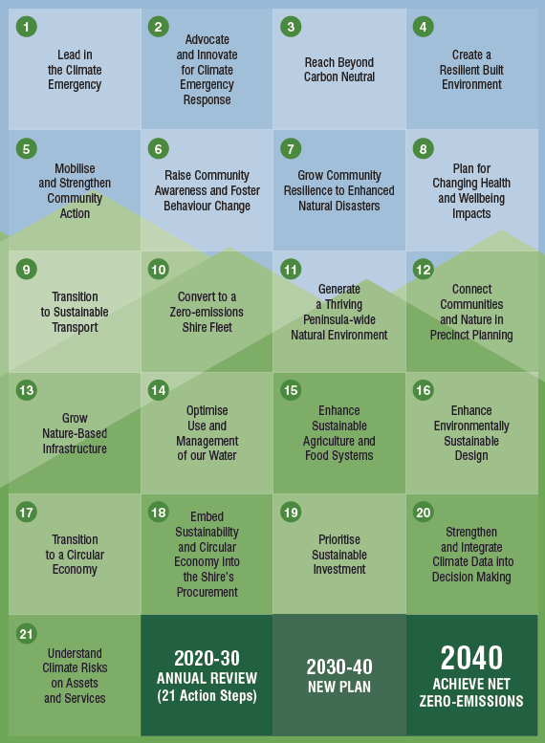
21 Actions in the plan
Action 11.1 focusses on the Biodiversity Conservation Plan
Many actions relate to and deliver on biodiversity
Notes:
Key target
Between 2020 and 2030, 1 million tonnes of atmospheric carbon will be sequestered on the Peninsula through terrestrial and aquatic plantings and improved soil conditions.
Supplementary targets
1: Each year there will be no new extinctions of indigenous species on the Peninsula
2: By 2025, existing established indigenous trees are protected
3: By 2030, 20% of local farms will adopt agroecological practices or transition to regenerative farming techniques
4: By 2025, increase human-nature connections by involving a total of 10,000 people in local terrestrial- and marine-based environmental care programs
5: By 2030, vegetation will be in place to increase shade to 45% in urban public spaces
6: By 2030, recycled water will be available in strategic Peninsula regions for agriculture and other beneficial purposes
7: By 2030, increase ecosystem resilience to climate change and other threats on the Peninsula, e.g. through restoring connectivity of habitat across public and private land.
8: By 2030, improve waterway health by 10% from 2020 levels

Slide 5
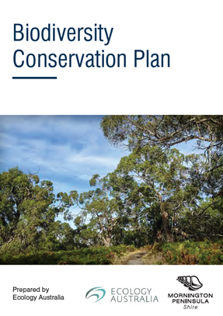
Engaging with the community and building stewardship
2. Facilitating biodiversity conservation on private land
3. Protecting biodiversity through planning and policy
4. Building a strong knowledge base
5. Demonstrating and leading best-practice land management
6. Building ecosystem resilience in a changing climate
Notes:
The biodiversity conservation plan has 6 strategic directions with over 40 actions which are designed to be implemented holistically to work toward ecosystem resilience. It was adopted by Council in August 2019. It is being implemented through extension of existing works programs, allocation of priority projects through the budget process and the Shire team working with community groups to further engage the broader community e.g Wor.

Slide 6
Recent Implementation Highlights
Action 1.8 Develop a biodiversity protection and management partnership with local Traditional Owners.
Bunurong Land Council’s Warreen Beek training group have begun a conservation and land management training program and undertake works in several bushland areas. The 2021 group includes members of Bunurong, Wurundjeri and Wathaurong.
We are developing a long-term works plan for Shire reserves at Tootgarook Wetland in collaboration with Bunurong Land Council, Trust for Nature and Melbourne Water.

Slide 7
Recent Implementation Highlights
Action 1.5 Partner with conservation and research organisations, such as BirdLife Australia, to develop and promote local biodiversity-related citizen science projects.
Current projects being promoted include Mornington Peninsula Biodiversity iNaturalist group, Birdlife Australia Backyard Bird Count and Birds in Schools and WaterWatch Victoria.
In 2021 Natural Systems will be partnering with Melbourne Water to deliver a Frog Census event.
Monitoring Powerful Owl breeding sites is on-going.

Slide 8
Recent Implementation Highlights
Action 2.2 Introduce an annual rate rebate for properties registered under a Trust for Nature covenant
The Shire now offers a discounted 'Trust for Nature' Rate to landholders who have placed a Trust for Nature conservation covenant on their property.
A conservation covenant is a permanent, legally binding agreement placed on a property's title to ensure the land is protected forever.
Under the Trust for Nature Rate, landholders receive a discount of 65% off their rates on the area of land protected under the covenant.

Slide 9
Recent Implementation Highlights
Action 6.2 Provide ongoing support to the community in planning and developing biolinks
A biolink, also known as a habitat corridor, links separate habitat patches and aims to support biodiversity through good design for each site
A biolink decision support tool was developed with the support of a focus group drawn from landcare groups and friends groups to highlight the science
Biolinks Support funding from the Shire is currently open for application till 5 March

